Slide 1
Parallel multi-objective GAs of fuzzy classier
11612126, Keming Li

Slide 2
Directions
Generally, Different parallel strategy is the different combinations of
1. data division,
2. selection method,
3. migration way
4. Data migration
Data division：
Based on class
Based on dimension
Selection(multi-objective):
Weight vector
NSGA-II
MOEA-D
…
Migration
Master-slave
Other Hierarchical model
Data migration:
Island model[1]
[1] H. Ishibuchi and Y. Nojima, “Analysis of interpretability-accuracy tradeoff of fuzzy systems by multiobjective fuzzy genetics-based machine learning,” International Journal of Approximate Reasoning, vol. 44, no. 1, pp. 4-31

Slide 3
Parameter setting
Our objectives are:
Minimize the rule number in the fuzzy set
Minimize the training error rate
Minimize the testing error rate
Data division
No data division
Selection:
NSGA-II
Migration
Master-slave(MS)
Hierarchical model: Ring
End with the same evaluation number 4e4
Ran in the same machine
pop1
pop4
pop4
pop3
pop2
Ring hierarchical migration

Slide 4
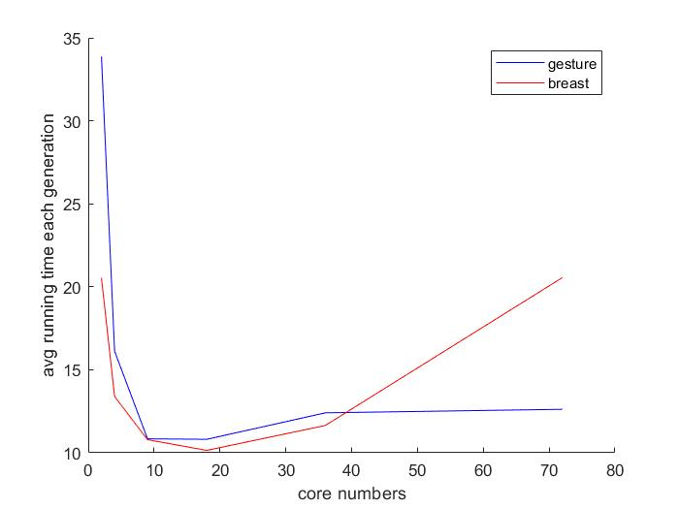
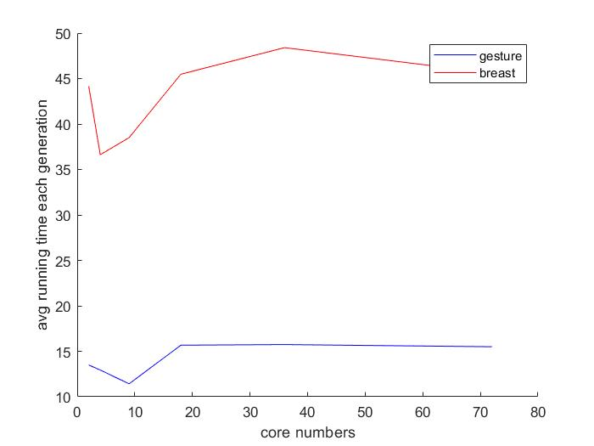
Evaluate time in different number of Cores
Master-slave
Ring
The processes’ communication time can be overhead respecting to cores’ number
For different dataset the best cores’ number is different

Slide 5
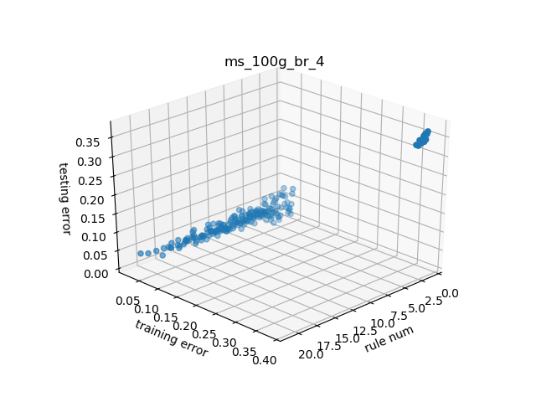
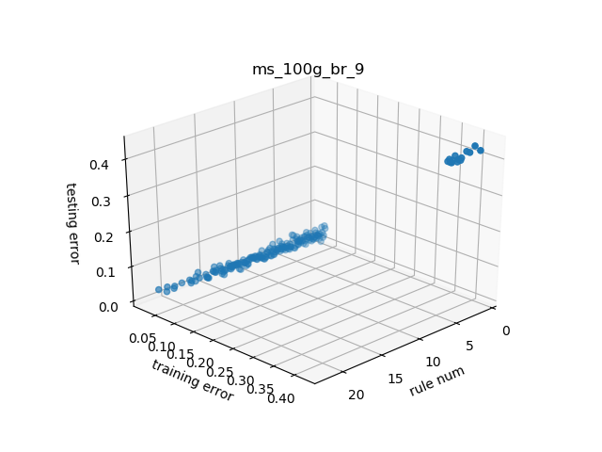
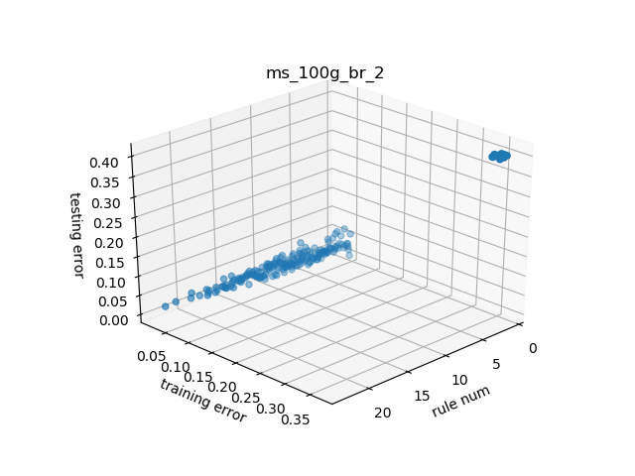
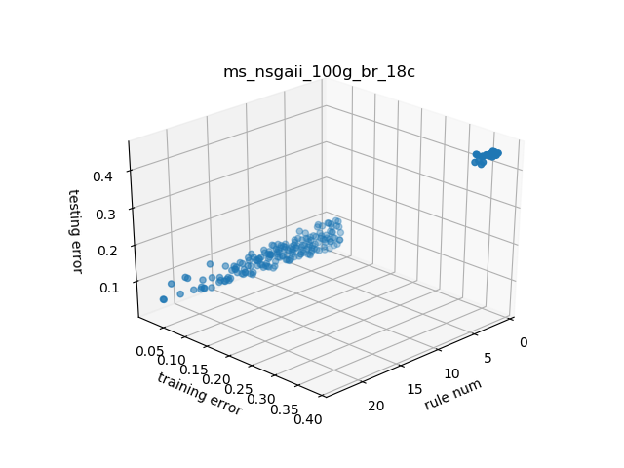
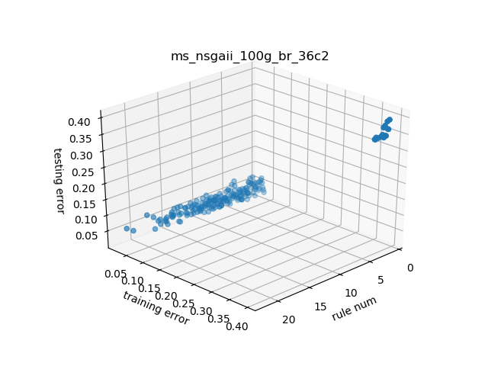
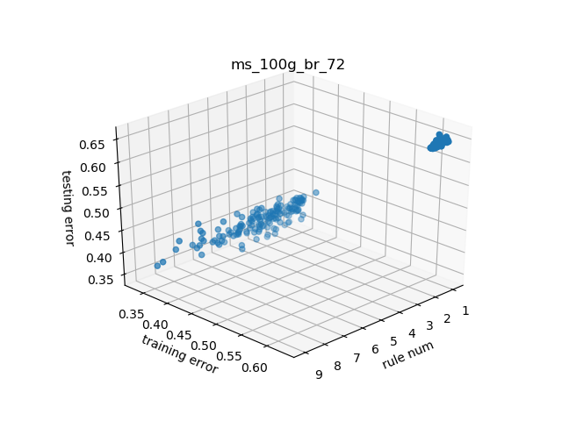
--master-slave: breast cancer data set

Slide 6
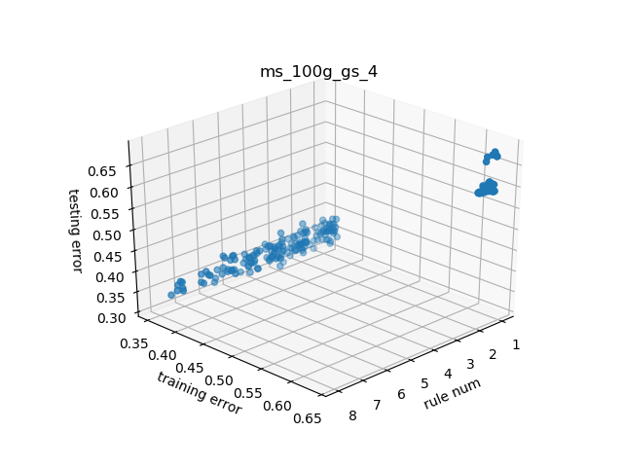
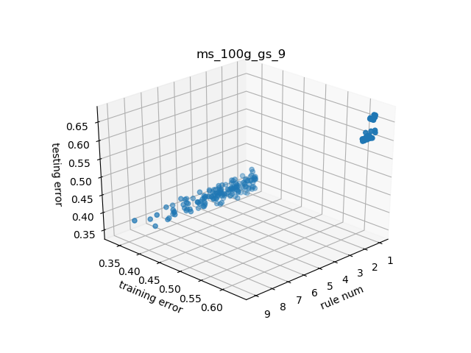
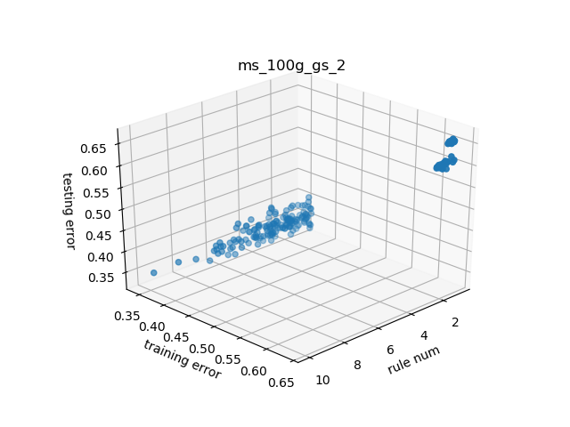
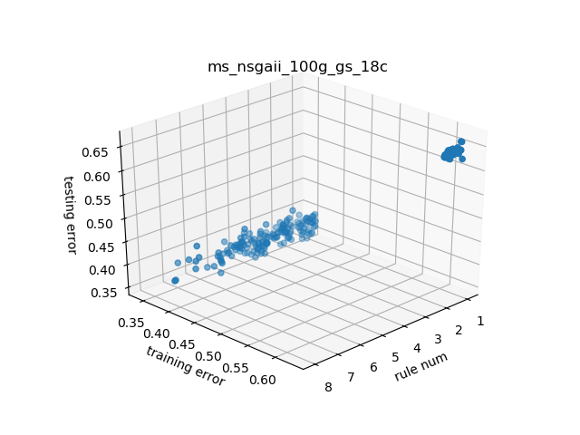
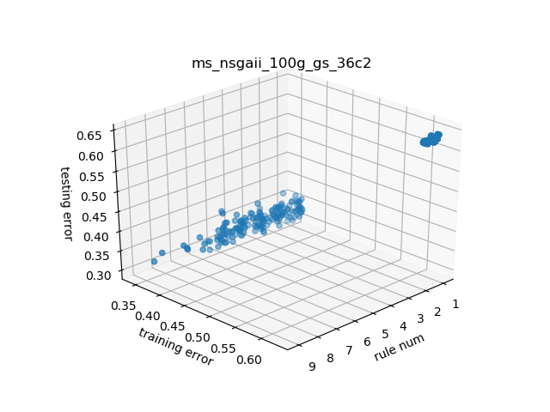
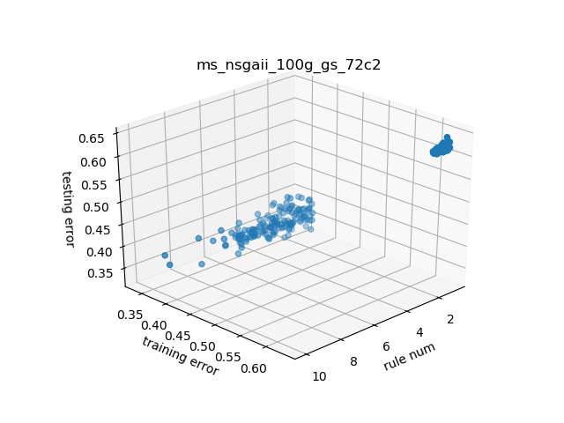
--master-slave: gesture data set

Slide 7
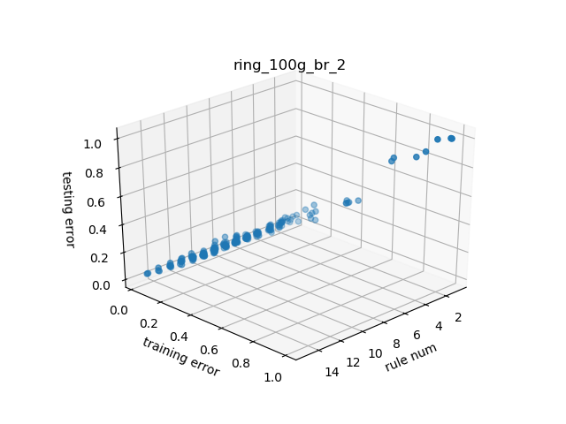


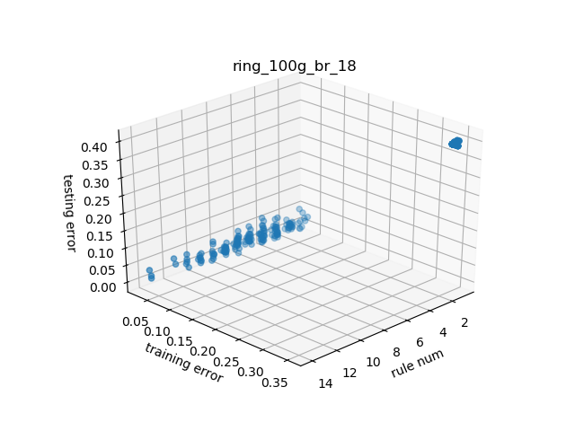

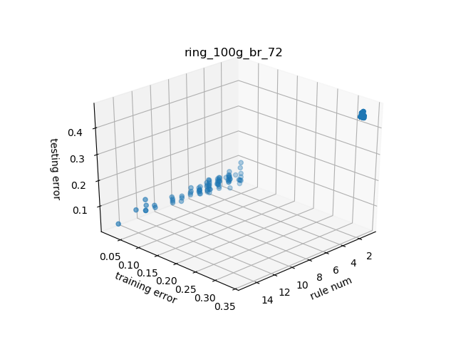
--ring: breast cancer dataset

Slide 8
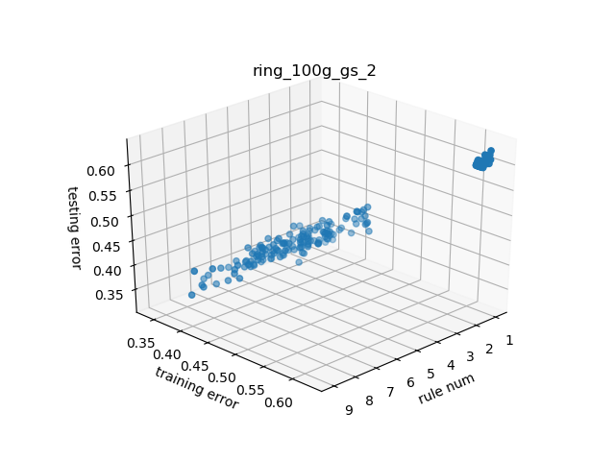
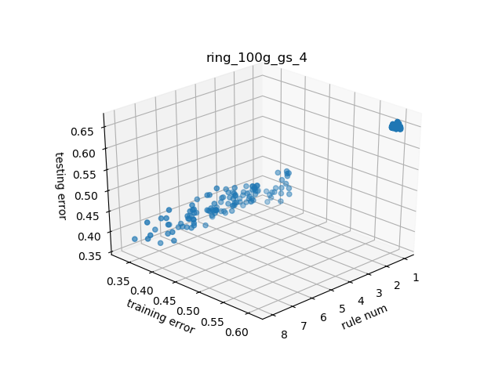
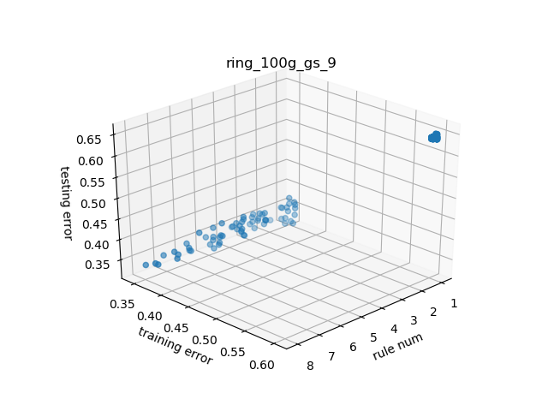
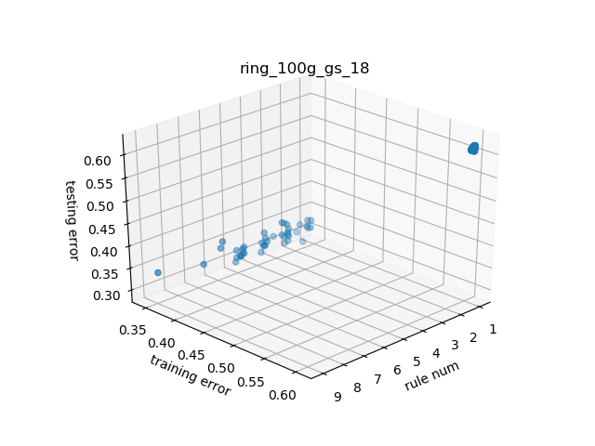
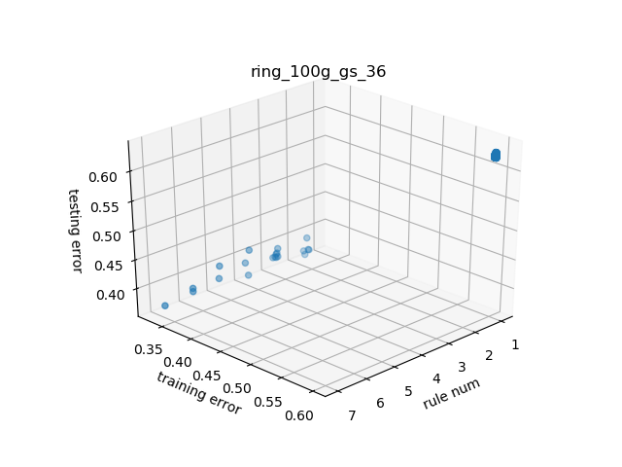
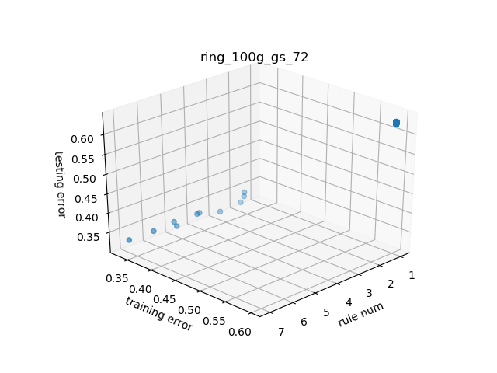
--ring: gesture dataset

Slide 9
Different migration: 2, 4, 9 cores

Slide 10
Different migration: 18, 36, 72 cores

Slide 11
When the cores number increase, the diversity of Ring decreases vary fast

Slide 12
Some problem for now
A lot of identity solutions is generated, take a lot of time to check
Process communication time is overhead respecting to computation time
More cores may be slower
The many-processing(respect to many-processing) program is hard to code: lock, semaphore synchronization, pipe programming, I/O, deadlock
This could be much more chaotic in a distributed system

